Slide 1
https://github.com/Peruvian-lily

Slide 2

OOP TEWMWORK
OOP Teamwork, team Peruvian-lily
SoftUni, February 2015

Slide 3
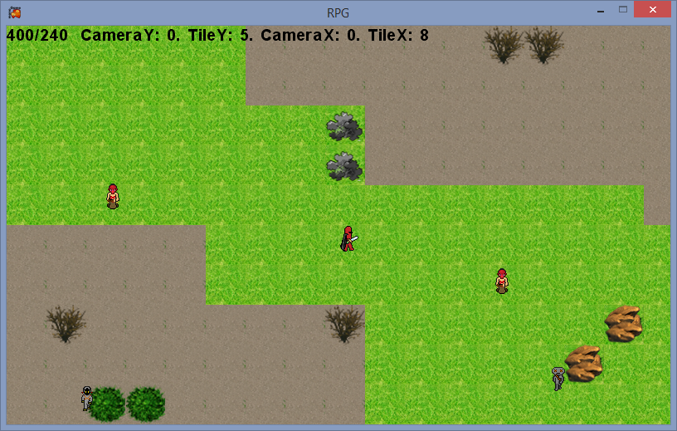
Project name and purpose
Name – “Threesome with Garnish”

Slide 4

Tools and resources
GitHub, XNA, Monogame, Coggle, Bootstrap
Facebook, Skype

